Slide 1

“PREDICTION OF EVAPORATION USING SOFT COMPUTING TECHNIQUES”
By
MEGHANA H P -1RN19CV023
NAMRATHA S -1RN19CV027
NISARGA K A -1RN20CV408
SWATHI K S -1RN20CV417
Under the guidance of:
Mr. Mahadeva M, BE,M.Tech,(Ph.d-UVCE)
ISRO-IIRS Institute Coordinator
Assistant professor
RNSIT,Bengaluru
RNS Institute of Technology,
(Affiliated to Visvesvaraya Technological University, Belagavi, Karnataka)
Dr. Vishnuvardhan Road, RR Nagar Post,
BENGALURU - 560098

Slide 2
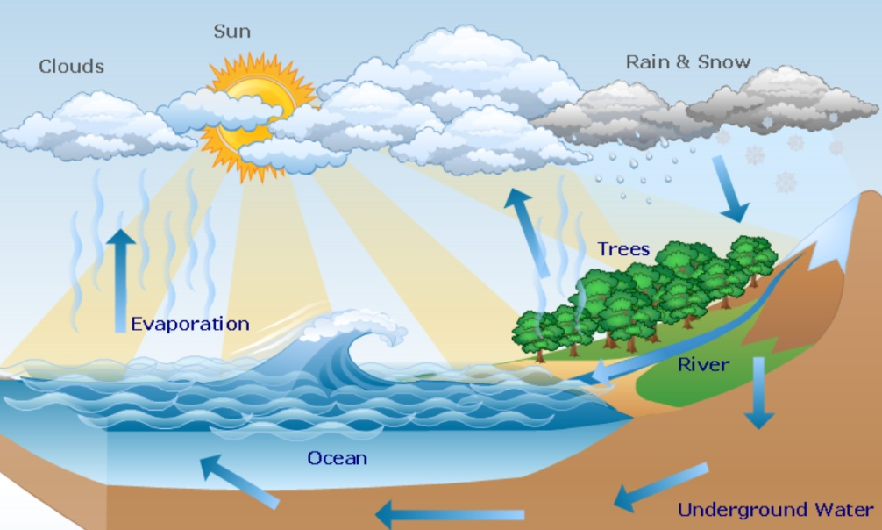
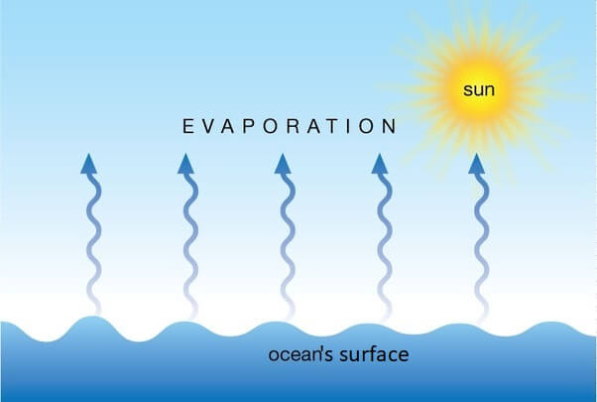
INTRODUCTION
Evaporation is the process where liquid water is converted to water vapour (vaporization) and removed from the evaporating surface (vapour removal).
Water evaporates from a variety of surfaces, such as lakes, rivers, pavements, soils and wet vegetation.
Fig.1: Hydrological cycle Fig. 2: Evaporation

Slide 3
INTRODUCTION
Energy is required to change the state of the molecules of water from liquid to vapour.
Direct solar radiation and, to a lesser extent, the ambient temperature of the air provide this energy.
The driving force to remove water vapour from the evaporating surface is the difference between the water vapour pressure at the evaporating surface and that of the surrounding atmosphere.
As evaporation proceeds, the surrounding air becomes gradually saturated and the process will slow down and might stop if the wet air is not transferred to the atmosphere.
The replacement of the saturated air with drier air depends greatly on wind speed. Hence, solar radiation, air temperature, air humidity and wind speed are climatological parameters to consider when assessing the evaporation process.
Where the evaporating surface is the soil surface, the degree of shading of the crop canopy and the amount of water available at the evaporating surface are other factors that affect the evaporation process.
Frequent rains, irrigation and water transported upwards in a soil from a shallow water table wet the soil surface.
Department of Civil Engineering, RNSIT Bengaluru. 3

Slide 4
NECESSITY OF THE EVAPORATION
In a developing country like India, for the development of new water resources, there are economic and environmental constraints.
Further, due to increasing municipal and its rapid increase need, there will be decreases in agriculture’s
share of water use.
Considering the above scenario of water resources and its rapid increase in demand, there is immense importance to properly plan and manage the water resources in order to increase agricultural production.
Evaporation is one of the basic components of the hydrological cycle and need to be estimated accurately as it plays a significant role in regional and global climates, and its estimation is of great importance in assessing groundwater recharge, predicting crop yield, planning land use, efficient operation scheduling, water balance studies, canal design capacities, reservoir operation studies, for rain fed agricultural production and crop water requirement studies.
India receives about 400 Mha-m water in the form of precipitation, of which 40% (160 Mha-m) is lost through evapotration, hence, the study of evapotration is of paramount importance.
Department of Civil Engineering, RNSIT Bengaluru. 4

Slide 5
MOTIVATION
The rising temperatures around the globe is a leading concern as there are many places which are scarce of water.
Through this study, it is possible to predict the evaporation in a place so that necessary measures can be taken for.
Reservoir planning.
Prevention of evaporation from water bodies so that water is adequately available for everyone for various purposes.

Slide 6
OBJECTIVES OF THE PROPOSED WORK
To Estimate the reference evaporation(ET) by using PM method(FAO 56).
To evaluate how much each metrological variables contributed to trend of ET.
To calculate each climate variables’ variations in ET i.e., sensitivity analysis.
To evaluate the performance ET calculations using ANN “Artificial Neural Network”.
Department of Civil Engineering, RNSIT Bengaluru. 6

Slide 7
PROPOSED METHODOLOGY
Start
Input
Meteorological Data (GKVK)
Data to be used
Sunshine Hours
Radiation
Air Temperature (Tmax, Tmin)
Humidity (RhMax and RHMin)
Wind Speed (us)
Penman Monteith Equation (PM Method) (FAO-56)
Trend analysis
Sensitivity Analysis
Artificial Neural Network
Result and Discussions

Slide 8
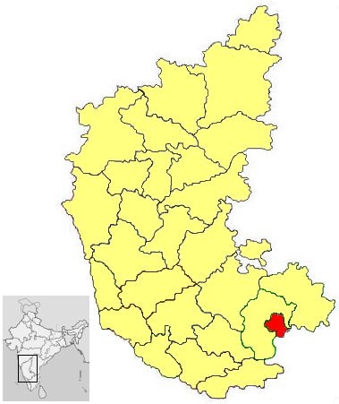
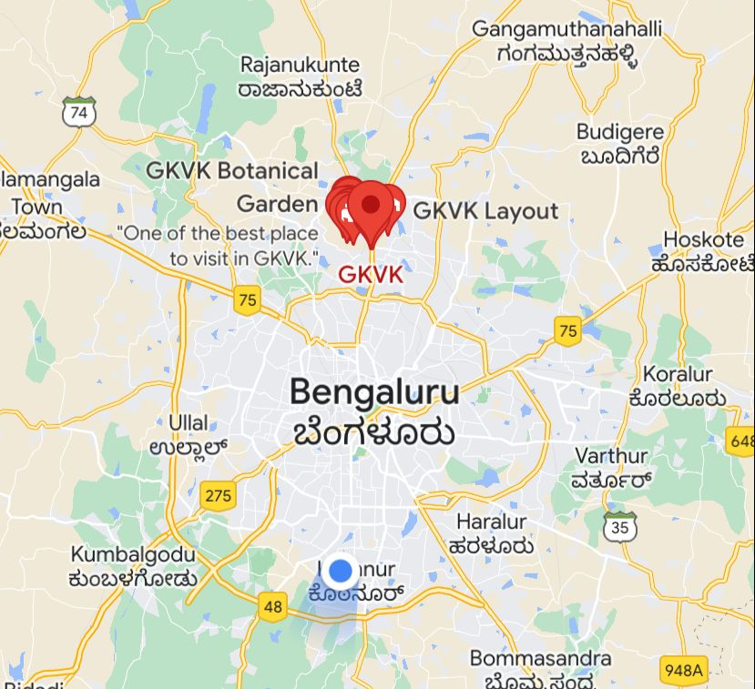
STUDY AREA
Sl. No. | Station | State | Latitude | Longitude | Altitude | Climate
1. | GKVK | Karnataka | 13.0801° N | 77.5785° E | 924m | Sub-Humid
Department of Civil Engineering, RNSIT Bengaluru. 8

Slide 9
DATA TO BE USED
The data needed and given by GKVK Bengaluru are as follows:
Maximum temperature
Minimum temperature
Altitude
Wind speed
Relative humidity
Sun shine hours
Department of Civil Engineering, RNSIT Bengaluru. 9

Slide 10
LITERATURE REVIEW
AUTHORS | TITLE OF THE PAPER | DESCRIPTION | CONCLUSIONS
1. Snyder et. al, (2005) Journal of Irrigation and drainge engineering (ASCE) | “Simplified Estimation of Reference Evapotranspiration from Pan Evaporation Data in California’ | Evaporation pan (Ep) data are often used to estimate reference evapotranspiration (ET0) for use in water resource planning and irrigation scheduling. This paper reviews equations to estimate ET0 from Ep and provides a simpler method to make this conversion for arid climatic conditions like in California. The new method accounts for fetch differences by first adjusting the Ep rates to values expected for 100 m of grass fetch. Then it relies on an empirical relationship between ET0 and the adjusted Ep to determine Kp values; thus, eliminating the need for relative humidity and wind speed data that are often unavailable. | For the California pan evaporation data in this study, the approach to adjust Ep data to estimate evaporation for 100 m fetch distances Epad using Eq. (8) and then to estimate ET0 from the Epa data using Eq. (9) gave better estimates than other equations in the literature that also require wind speed and humidity data. Asine-wave approach was used to estimate ET0 from the adjusted Epa data. The model worked well in an arid climate like California; however, adjustments might be needed for more humid or windier climate

Slide 11
LITERATURE REVIEW
AUTHORS | TITLE OF THE PAPER | DESCRIPTION | CONCLUSIONS
2.Terzi et,al (2006) Journal of Irrigation and drainge engineering (ASCE) | “Estimating Evaporation Using ANFIS” | Water resources engineering assessment requires simple but effective evaporation estimation procedures, especially from readily measurable meteorological factors. Unfortunately, such approaches are rather scarce in the literature. In this paper, an adaptive neural-based fuzzy inference system (ANFIS) was applied to daily meteorology data from the Lake Egirdir region in the south-western part of Turkey. Daily evaporation, solar radiation, air and water temperatures, and relative humidity measurements were used to develop the ANFIS method, which helps to assess possible contributions that each input variable has on the evaporation estimates. Such an assessment is not possible by any conventional procedure including the Penman method. The estimation results from the ANFIS model had a high coefficient of determination of 0.98 when compared with the Penman method results and a low average performance error of 4.6% among other alternatives. | Lake Egirdir lies in the south-western part of Turkey, and its hydrological balance necessitates the estimation of evaporation rates from a set of measured meteorological factors such as evaporation, air temperature, water temperature, relative humidity, solar radiation, wind speed, and air pressure. The classical Penman equation is suitable for such a task, but it has restrictive assumptions and includes additional parameters other than meteorological measurements.
Department of Civil Engineering, RNSIT Bengaluru. 11

Slide 12
LITERATURE REVIEW
AUTHORS | TITLE OF THE PAPER | DESCRIPTION | CONCLUSIONS
3. Cahoon et,al,(1990) Agricultural and Forest Meteorology (Elsevier) | Estimating pan evaporation using limited meteorological observations | Pan evaporation measurements have been used worldwide as a means of estimating evapotranspiration and free water surface evaporation. The availability of pan evaporation measurements is critical to many applications including irrigation scheduling, hydro logic modeling, and irrigation system design. The ability to predict daily pan evaporation based on limited meteorological observations is highly desirable. In many situations it is advantageous to calculate, rather than measure, pan evaporation. In many situations it is advantageous to calculate, rather than measure, pan evaporation. This is often the case in developing nations or remote locations where costs are prohibitive. A calibration procedure is presented and demonstrated by calibrating three equations using data from several sites located in the southeaster United States. | Algorithms requiring limited meteorological observations for computing pan evaporation are an important component of many hydrologic applications. A technique for using measured pan evaporation to determine local calibration coefficients for equations that predict pan evaporation or PET is presented. This technique is valuable for establishing a calibrated equation for a site having pan evaporation data that is then transferable to locations nearby having similar climatic characteristics.
Department of Civil Engineering, RNSIT Bengaluru. 11

Slide 13
LITERATURE REVIEW
AUTHORS | TITLE OF THE PAPER | DESCRIPTION | CONCLUSIONS
4. M.O. Ahmed et,al(2020-21) Journal of Fundamental and Applied science (Libraries resource Directory) | “Trend analysis of evaporation and solar radiation using innovative trend analysis method” | Analysis of trends in monthly evaporation and solar radiation in the face of climate change gives useful information for better planning and management of water resources. This paper examines the monthly evaporation and solar radiation trend using the recently developed innovative trend analysis method (ITAM). The monthly evaporation trend result shown that 75% of the months indicated decreasing trend with the month of February, March, August and April decreased significant at 0.1%, 10%, 10% and 5% significance level respectively. | In this study, trends in monthly evaporation and solar radiation were examined using the innovative trend analysis method (ITAM) and also by Mann-Kendall with Sen’s slope test in Ibadan metropolis, Nigeria. The results obtained from the ITAM for evaporation and solar radiation is similar to the ones obtained through the Mann-Kendall test except in some months
Department of Civil Engineering, RNSIT Bengaluru. 12

Slide 14
LITERATURE REVIEW
AUTHORS | TITLE OF THE PAPER | DESCRIPTION | CONCLUSIONS
5. I. J. VERMAE et,al,(2006-2008) Journal of Irrigation and drainge engineering (ASCE) | “Recent variations and trends in pan evaporation over India” | Thirty years pan evaporation time series data (1971-2000) recorded from US class-A evaporation pans for twenty well distributed locations in India, have been utilized in the present study. For all the locations, basic statistical parameters of annual evaporation [minimum, maximum, range, mean, standard deviation (S.D.) and coefficient of variation (C.V.)] have been computed. Annual, seasonal and monthly trends have been studied using linear trend analysis technique. | (i)The mean annual pan evaporation was found to be the lowest (1107 mm) at Buralikson and the highest (3004 mm) at Rajkot. (ii)The highest C.V. (11%) was observed at Rajahmundry, Jodhpur, Buralikson and Nellore while the lowest C.V. (2%) was observed at Ambikapur. (iii)Out of twenty locations, significant decreasing trend in annual pan evaporation was observed at fifteen locations and no significant trend at five locations.
Department of Civil Engineering, RNSIT Bengaluru. 13

Slide 15
LITERATURE REVIEW
AUTHORS | TITLE OF THE PAPER | DESCRIPTION | CONCLUSIONS
6. Hossein Tabard et,al(2010) Water Resource Manager (Springer) | Changes of Pan Evaporation in the West of Iran | Evaporation is an important component of the hydrological cycle and its change would be of great significance for water resources planning, irrigation control and agricultural production. The main purpose of this study was to investigate temporal variations in pan evaporation (Epan) and the associated changes in maximum (Tmax), mean (Tmean) and minimum (Tmin) air temperatures and precipitation (P) for 12 stations in Hamedan province in western Iran for the period 1982–2003. | In this study, we analyzed changes of observed Epan and the associated variations in Tmax, Tmean, Tmin and P data for 12 stations in Hamedan province in western Iran from 1982 to 2003. Trend analysis was carried out by the Mann–Kendall test, the Sen’s slope estimator and the linear regression method. Significantly increasing Epan was observed in 67% of the stations at the 95% and 99% confidence levels. The results of this research revealed that the study area has become more arid in recent years.
Department of Civil Engineering, RNSIT Bengaluru. 14

Slide 16
LITERATURE REVIEW
AUTHORS | TITLE OF THE PAPER | DESCRIPTION | CONCLUSIONS
7.Benzghta et. al. (2021), Scientific Research and Essays | “Prediction of evaporation in tropical climate using artificial neural network and climate based models” | The evaporation from Batu dam, located in Malaysia is estimated using selected models namely the artificial neural networks (ANN) models and climate based models (Penman and Priestly-Taylor). Data acquired from dam authority was used to run these models. | Statistical tests conducted on the models output reveal that ANN-4 model is the best among the tested ANN models with coefficient of efficiency of 90%. However, Priestly-Taylor model gave better accuracy than Penman model with CE of 82%.
Department of Civil Engineering, RNSIT Bengaluru. 15

Slide 17
LITERATURE REVIEW
AUTHORS | TITLE OF THE PAPER | DESCRIPTION | CONCLUSIONS
8. Pankaj Kumar and Ajai Kumar Tiwari(2012), International Journal of omputer Theory And Engineering. | Evaporation Estimation using Artificial Neural Network | The empirical formulas available for evaporation estimation are not satisfactory due to the complex nature of the evaporation process and the data availability. For this purpose, artificial neural networks (ANN) models was developed to estimate monthly potential evaporation in Pantagar, US Nagar (India) based on four instructive climatic factors. Observations of relative humidity, solar radiation, temperature, wind speed and evaporation for the past 19 years and 8 months | The results are quite encouraging and suggest the usefulness of neural network based modeling technique in accurate prediction of the evaporation. Combination of mean air temperature, wind speed, sunshine hour and mean relative humidity provides better performance in predicting the evaporation losses.
Department of Civil Engineering, RNSIT Bengaluru. 16

Slide 18
LITERATURE REVIEW
AUTHORS | TITLE OF THE PAPER | DESCRIPTION | CONCLUSIONS
9. Surinder Deswal and Mahesh Pal(2008), World Academy of Science | Artificial Neural Network based Modeling of Evaporation Losses in Reservoirs | The prediction accuracy of artificial neural network has been compared with the accuracy of linear regression approach. | The results suggest the usefulness of neural network based modeling technique in accurate prediction of the evaporation
Department of Civil Engineering, RNSIT Bengaluru. 17

Slide 19
LITERATURE REVIEW
AUTHORS | TITLE OF THE PAPER | DESCRIPTION | CONCLUSIONS
10. Anurag Malik, Anil Kumar and Ozgur Kisi(2018) J. Irrig. Drain. Eng. | Daily Pan Evaporation Estimation Using Heuristic Methods | Climate-based emperical models such as Penmann, Stephens-Stewart, Griffiths, Christiansen, Preistely-Taylor and Jensen-Burman-Allen were borrowed. | Penmann and Stephens-Stewart models were the most accurate.
Department of Civil Engineering, RNSIT Bengaluru. 18

Slide 20
LITERATURE REVIEW
AUTHORS | TITLE OF THE PAPER | DESCRIPTION | CONCLUSIONS
11. Subhankar Debnath, Sirisha Adamala and N. S. Raghuwanshi (2015) Springer International Publishing Switzerland | Sensitivity Analysis of FAO-56 Penman-Monteith Method for Different Agro-ecological Regions of India | Sensitivity Analysis and Sensitivity Coefficients: A common approach for analyzing sensitivity is to explore the effects of change in input variables, one at a time, on an output variable. The sensitivity coefficients for each climatic variable (i.e., Tmax, Tmin, Rs, RHavg, and Ws) were derived from the ratio of change in ETo to the unit of change (either increase or decrease) in each climatic variable on a daily basis. Cs=CH_{ETo}/CH_{CV} | It was found that wind speed and net radiation are the most and the second most affecting factors for evaporation respectively.
Department of Civil Engineering, RNSIT Bengaluru. 25

Slide 21
m
LITERATURE REVIEW
AUTHORS | TITLE OF THE PAPER | DESCRIPTION | CONCLUSIONS
12. Milan Gocic and Slavisa Trajkovic(2013) Global and planetary change | Analysis of changes in meteorological variables using Mann-Kendall and Sen's slope estimator statistical tests in Serbia | Mann-Kendall method was used to determine whether there was a positive or negative trend in weather data with their statistical significance | A positive trend was observed in climate variables. Those are Tmax, Tmin, RH. a negative trend was observed in wind speed and sun shine hours.
Department of Civil Engineering, RNSIT Bengaluru. 29

Slide 22

Objective: To find the reference Evaporation values 1.Penman-Monteith Equation
METHODOLOGY
ET = reference evaporation [mm],
Rn = net radiation at the crop surface [MJ m-2 day-1],
G = soil heat flux density [MJ m-2 day-1],
T =mean daily air temperature at 2 m height [°C],
u2 =wind speed at 2 m height [m s-1],
es =saturation vapour pressure [kPa],
ea = actual vapour pressure [kPa],
es-ea= saturation vapour pressure deficit [kPa],
∆ = slope vapour pressure curve [kPa °C-1],
γ = psychrometric constant [kPa °C-1].
Department of Civil Engineering, RNSIT Bengaluru. 19

Slide 23
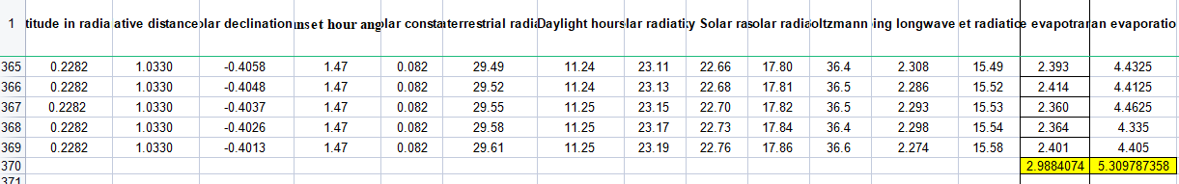
METHODOLOGY
Estimation of ET (PM Method) using Excel sheet w.r.t. FAO-56 (Prepared) Conti...
Department of Civil Engineering, RNSIT Bengaluru. 20

Slide 24

2. Stephen-Stewart model
METHODOLOGY
Ep=Rs(a + b*Tmean)
where Ep= predicted pan evaporation
a= fitting coefficient
b= fitting coefficient
Tmean= Mean temperature
Rs=Solar radiation.
Department of Civil Engineering, RNSIT Bengaluru. 21

Slide 25
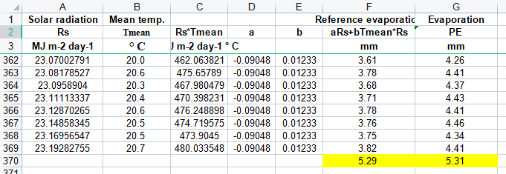
METHODOLOGY
Estimation of ET (Stephen-Stewart model) using Excel sheet (Prepared) Conti...
Department of Civil Engineering, RNSIT Bengaluru. 22

Slide 26
Comparison between Conventional methods and Actual evaporation
Penman-Monteith method
with an RMSE error of 0.121
Stephen-Stewart model
with an RMSE error of 0.035
Department of Civil Engineering, RNSIT Bengaluru. 23

Slide 27
Sensitivity Analysis and Sensitivity Coefficients
The sensitivity coefficient for each climatic variable (i.e., Tmax, Tmin, Rs, RHavg, and Ws) were derived from the ratio of change in ETo to the unit of change in each climatic variable on a daily basis. It is represented as follows:
C_{s} = CH_{ETo} /CH_{CV}
where C_{s} = sensitivity coefficient
CH_{ETo} = change in ETo with respect to change in climate variables
CH_{CV} = change in climate variable
Department of Civil Engineering, RNSIT Bengaluru. 26

Slide 28
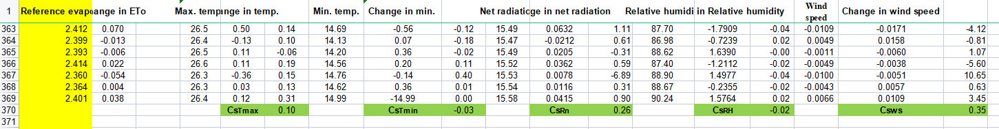
Sensitivity Analysis and Sensitivity Coefficients
It was found that wind speed and net radiation are the most and the second most affecting factors for evaporation respectively.
Department of Civil Engineering, RNSIT Bengaluru. 27

Slide 29
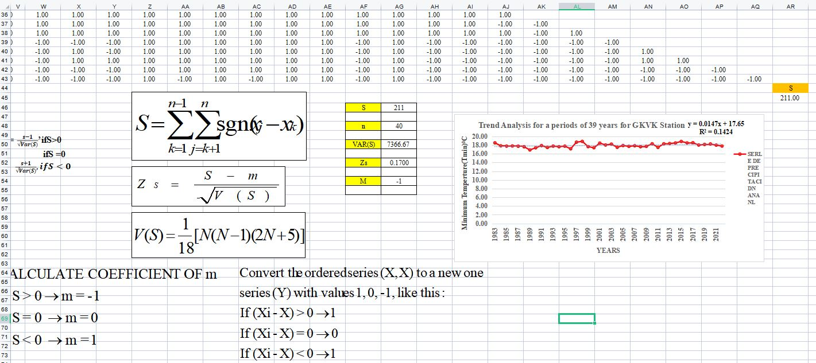
Minimum temperature trend
Trend Analysis
Department of Civil Engineering, RNSIT Bengaluru. 30

Slide 30
Minimum temperature trend
Trend Analysis
Department of Civil Engineering, RNSIT Bengaluru. 31

Slide 31
Maximum temperature trend
Trend Analysis
Department of Civil Engineering, RNSIT Bengaluru. 32

Slide 32
Wind speed trend
Trend Analysis
Department of Civil Engineering, RNSIT Bengaluru. 33

Slide 33
Sunshine hours trend
Trend Analysis
Department of Civil Engineering, RNSIT Bengaluru. 34

Slide 34
Relative humidity trend
Trend Analysis
Department of Civil Engineering, RNSIT Bengaluru. 35

Slide 35
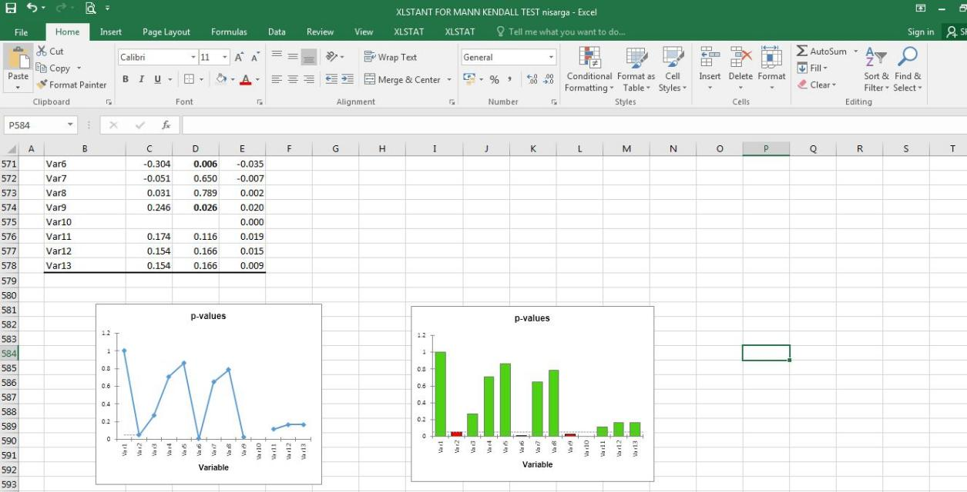
Maximum temperature trend
Trend Analysis
Department of Civil Engineering, RNSIT Bengaluru. 35

Slide 36
Maximum temperature trend
Trend Analysis
Series\Test | Kendall's tau | p-value | Sen's slope
Dec | 0.004 | 1.99 | 0.025
Jan | 0.218 | 1.97 | 0.026
Feb | 0.123 | 1.11 | 0.014
Marc | 0.042 | 0.37 | 0.007
Apr | 0.021 | 0.17 | 0.002
May | -0.304 | -2.75 | -0.035
Jun | -0.051 | -0.43 | -0.007
Jul | 0.031 | 1.01 | 0.011
Aug | 0.246 | 2.23 | 0.02
Sep | 0.174 | 0.44 | 0.004
Oct | 0.154 | 1.57 | 0.019
Nov | 0.154 | 1.29 | 0.014
Department of Civil Engineering, RNSIT Bengaluru. 35

Slide 37
Minimum temperature trend
Trend Analysis
Series\Test | Kendall's tau | p-value | Sen's slope
Dec | 0.005 | 1.000 | 0.000
Jan | 0.318 | 0.049 | 0.026
Feb | 0.223 | 0.268 | 0.014
Marc | 0.052 | 0.709 | 0.007
Apr | 0.031 | 0.861 | 0.002
May | -0.404 | 0.006 | -0.035
Jun | -0.041 | 0.650 | -0.007
Jul | 0.021 | 0.789 | 0.002
Aug | 0.346 | 0.026 | 0.020
Sep | 0.184 | 0.116 | 0.019
Oct | 0.194 | 0.166 | 0.015
Nov | 0.254 | 0.166 | 0.009
Department of Civil Engineering, RNSIT Bengaluru. 35

Slide 38
Wind speed trend
Trend Analysis
Series\Test | Kendall's tau | p-value | Sen's slope
Dec | -0.204 | 0.078 | -0.064
Jan | -0.123 | 0.300 | -0.052
Feb | -0.241 | 0.023 | -0.025
Marc | -0.479 | < 0.0001 | -0.04
Apr | -0.507 | < 0.0001 | -0.068
May | -0.523 | < 0.0001 | -0.094
Jun | -0.072 | 0.600 | -0.191
Jul | -0.174 | 0.118 | -0.148
Aug | -0.219 | 0.050 | -0.137
Sep | -0.338 | 0.003 | -0.046
Oct | -0.149 | 0.190 | -0.054
Nov | -0.546 | < 0.0001 | -0.019
Department of Civil Engineering, RNSIT Bengaluru. 35

Slide 39
Sunshine hours trend
Trend Analysis
Series\Test | Kendall's tau | p-value | Sen's slope
Dec | -0.204 | 0.066 | -0.040
Jan | -0.123 | 0.268 | -0.012
Feb | -0.241 | 0.029 | -0.023
Marc | -0.479 | < 0.0001 | -0.043
Apr | -0.507 | < 0.0001 | -0.040
May | -0.523 | < 0.0001 | -0.055
Jun | -0.072 | 0.522 | -0.006
Jul | -0.174 | 0.116 | -0.016
Aug | -0.219 | 0.048 | -0.028
Sep | -0.338 | 0.002 | -0.052
Oct | -0.149 | 0.180 | -0.019
Nov | -0.546 | < 0.0001 | -0.027
Department of Civil Engineering, RNSIT Bengaluru. 35

Slide 40
Sunshine hours trend
Trend Analysis
Series\Test | Kendall's tau | p-value | Sen's slope
Dec | -0.204 | 3.92 | -0.040
Jan | -0.123 | 4.25 | -0.012
Feb | -0.241 | 0.37 | -0.023
Marc | -0.479 | 5.63 | -0.043
Apr | -0.507 | 4.24 | -0.040
May | -0.523 | 4.11 | -0.055
Jun | -0.072 | 2.95 | -0.006
Jul | -0.174 | 4.79 | -0.016
Aug | -0.219 | 4.57 | -0.028
Sep | -0.338 | 4.32 | -0.052
Oct | -0.149 | 4.09 | -0.019
Nov | -0.546 | 4.11 | -0.027
Department of Civil Engineering, RNSIT Bengaluru. 35

Slide 41
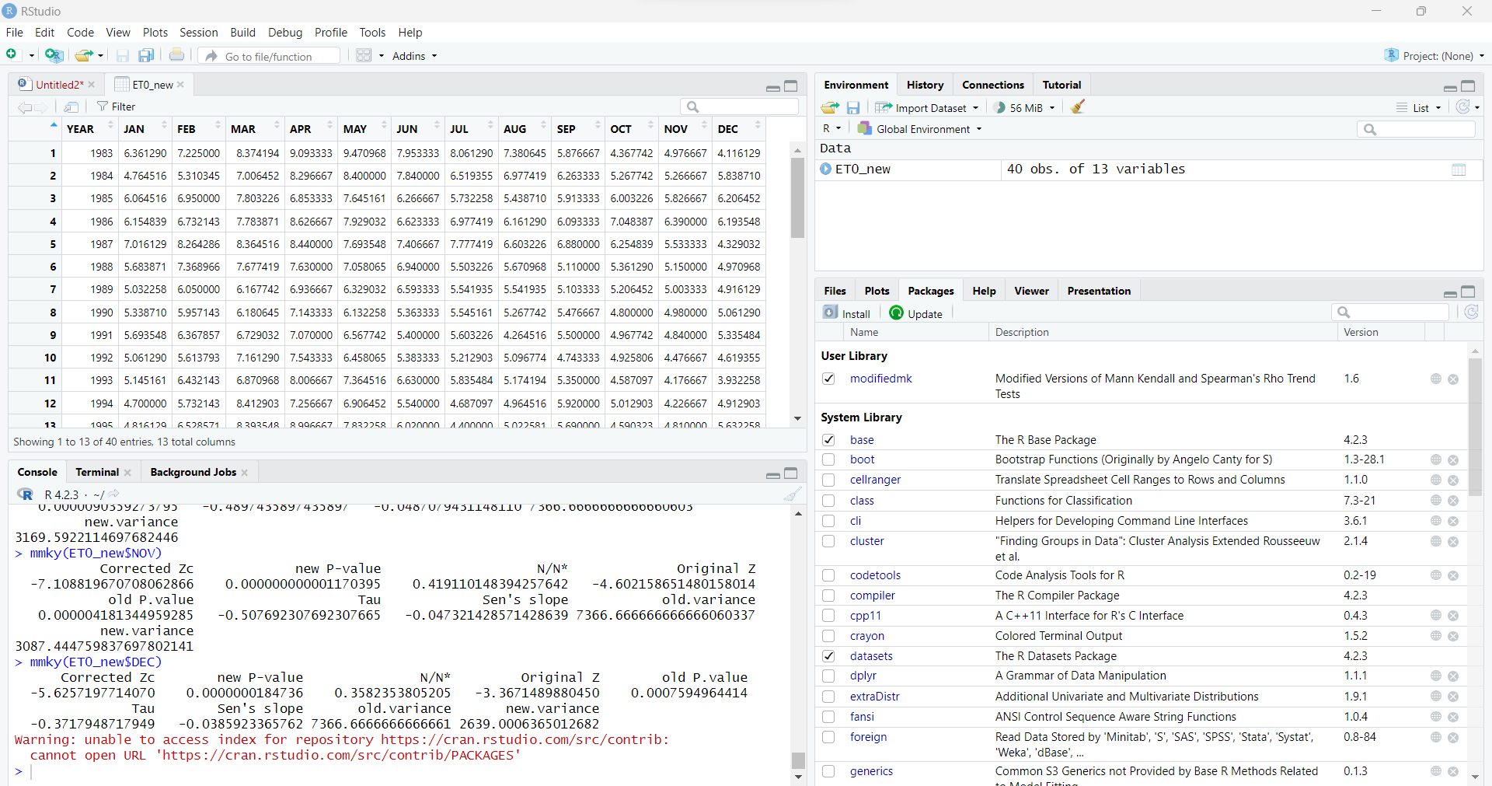
Trend Analysis
R Studio - Mannkendall Method
Department of Civil Engineering, RNSIT Bengaluru.

Slide 42
Trend Analysis
R Studio - Mannkendall Method
MANNKENDALL | JAN | FEB | MAR | APR | MAY | JUN | JUL | AUG | SEP | OCT | NOV | DEC
Tmax | 1.97 | 1.11 | 0.37 | 0.17 | -2.75 | -0.43 | 1.01 | 2.23 | 0.44 | 1.57 | 1.29 | 1.99
Tmin | 1.22 | -0.31 | 1.40 | 0.36 | -0.43 | 1.78 | 1.61 | 1.61 | 1.26 | 1.03 | 1.90 | 2.20
WS | -3.41 | -1.20 | -2.48 | -4.17 | -3.53 | -5.00 | -4.39 | -3.88 | -2.11 | -2.99 | -1.22 | -3.32
RS | 4.25 | 0.37 | 5.63 | 4.24 | 4.11 | 2.95 | 4.79 | 4.57 | 4.32 | 4.09 | 4.11 | 3.92
EPan | -4.80 | -3.41 | -1.08 | -2.04 | -4.33 | -4.81 | -5.91 | -6.37 | -5.67 | -4.44 | -4.60 | -3.37
SSH | -1.48 | -1.48 | -4.70 | -4.89 | -5.16 | -0.52 | -2.04 | -2.47 | -3.41 | -1.88 | -1.53 | -2.26
MANNKENDALL | JAN | FEB | MAR | APR | MAY | JUN | JUL | AUG | SEP | OCT | NOV | DEC
Tmax | 1.97 | 1.11 | 0.37 | 0.17 | -2.75 | -0.43 | 1.01 | 2.23 | 0.44 | 1.57 | 1.29 | 1.99
Tmin | 1.22 | -0.31 | 1.40 | 0.36 | -0.43 | 1.78 | 1.61 | 1.61 | 1.26 | 1.03 | 1.90 | 2.20
WS | -3.41 | -1.20 | -2.48 | -4.17 | -3.53 | -5.00 | -4.39 | -3.88 | -2.11 | -2.99 | -1.22 | -3.32
RS | 4.25 | 0.37 | 5.63 | 4.24 | 4.11 | 2.95 | 4.79 | 4.57 | 4.32 | 4.09 | 4.11 | 3.92
EPan | -4.80 | -3.41 | -1.08 | -2.04 | -4.33 | -4.81 | -5.91 | -6.37 | -5.67 | -4.44 | -4.60 | -3.37
SSH | -1.48 | -1.48 | -4.70 | -4.89 | -5.16 | -0.52 | -2.04 | -2.47 | -3.41 | -1.88 | -1.53 | -2.26
Department of Civil Engineering, RNSIT Bengaluru.

Slide 43
Trend Analysis
R Studio - Mann Kendall Method
Department of Civil Engineering, RNSIT Bengaluru.

Slide 44
R Studio - Sen’s slope Method
Trend Analysis
SENSLOPE | JAN | FEB | MAR | APR | MAY | JUN | JUL | AUG | SEP | OCT | NOV | DEC
Tmax | 0.026 | 0.014 | 0.007 | 0.002 | -0.035 | -0.007 | 0.011 | 0.020 | 0.004 | 0.019 | 0.014 | 0.025
Tmin | 0.024 | -0.006 | 0.026 | 0.005 | -0.005 | 0.013 | 0.014 | 0.013 | 0.007 | 0.011 | 0.024 | 0.040
WS | -0.052 | -0.025 | -0.040 | -0.068 | -0.094 | -0.191 | -0.148 | -0.137 | -0.046 | -0.054 | -0.019 | -0.064
RS | 0.218 | 0.374 | 0.444 | 0.237 | 0.244 | 0.174 | 0.206 | 0.202 | 0.196 | 0.170 | 0.263 | 0.231
EPan | -0.044 | -0.039 | -0.010 | -0.031 | -0.068 | -0.073 | -0.075 | -0.081 | -0.071 | -0.049 | -0.047 | -0.039
SSH | -0.015 | -0.015 | -0.047 | -0.041 | -0.064 | -0.005 | -0.022 | -0.036 | -0.059 | -0.032 | -0.023 | -0.050
Department of Civil Engineering, RNSIT Bengaluru.

Slide 45
R Studio - Sen’s slope Method
Trend Analysis
Department of Civil Engineering, RNSIT Bengaluru.

Slide 46
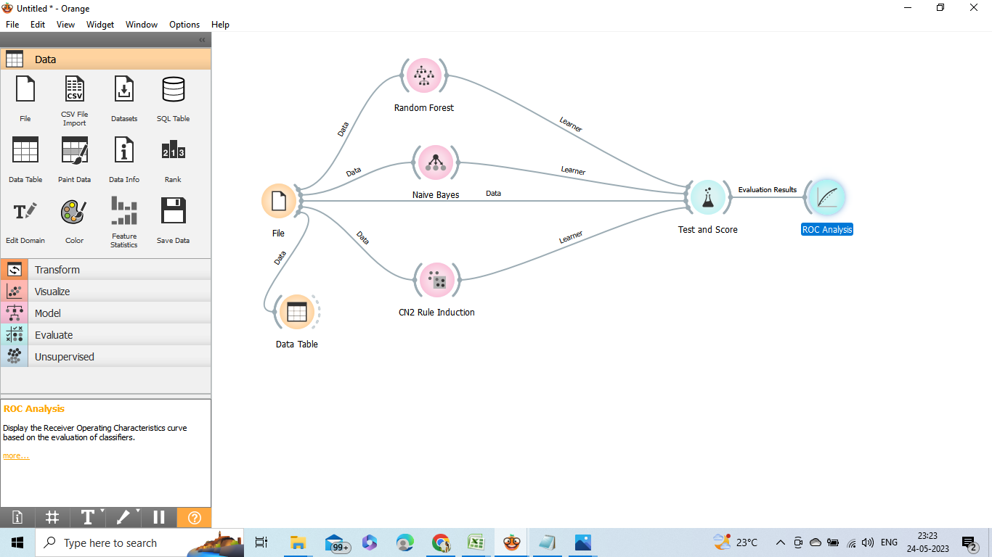

Artificial Neural Network
Orange application was used for this.
Three tests were done separately on the Penman model and the Stephans-Stewart model and the data’s performances were evaluated in terms of Accuracy and Precision.
Department of Civil Engineering, RNSIT Bengaluru.

Slide 47
Artificial Neural Network

Slide 48
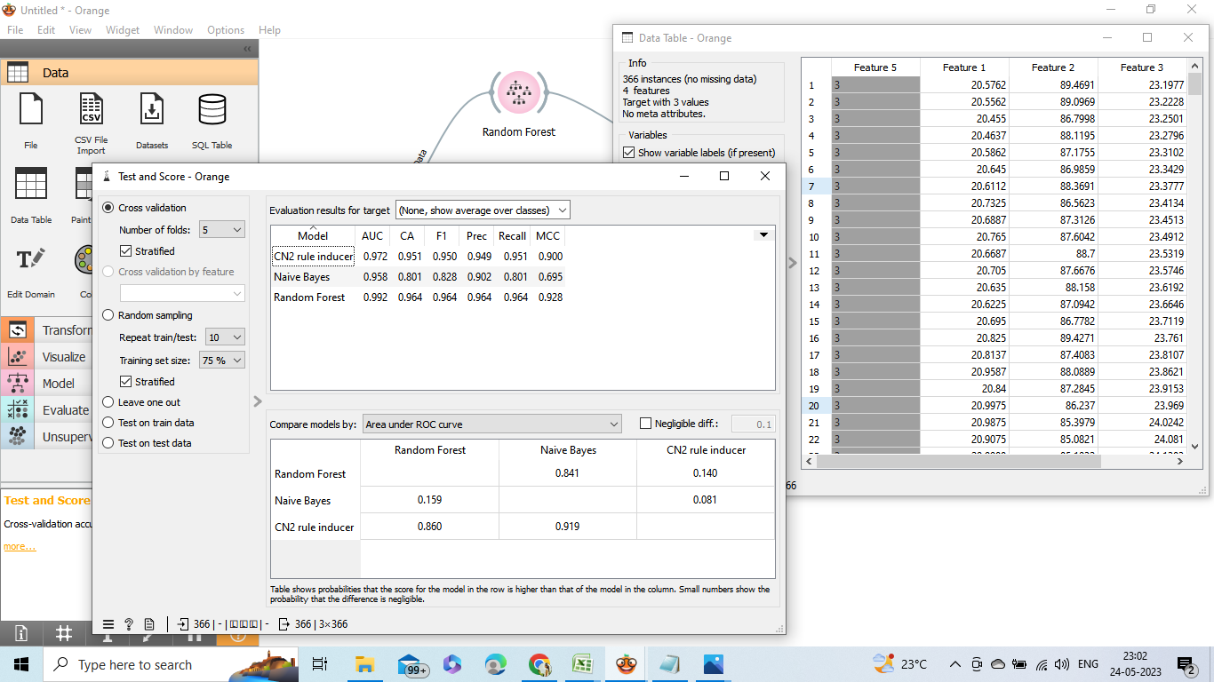
Artificial Neural Network
Performance evaluation
Department of Civil Engineering, RNSIT Bengaluru.

Slide 49
Artificial Neural Network
Performance evaluation
It is observed that the overall performance of Stefans-Stewart model is greater than the Penman-Monteith model as it was predicted in the conventional method
EVAPORATION MODEL | PERFORMANCE MODEL | ACCURACY | PRECISION
Penman-Monteith | CN2 rule inducer | 0.972 | 0.949
 | Naive Bayes | 0.958 | 0.902
 | Random Forest | 0.992 | 0.964
Stefans-Stewart | CN2 rule inducer | 0.987 | 0.981
 | Naive Bayes | 0.960 | 0.763
 | Random Forest | 1.000 | 0.992
Department of Civil Engineering, RNSIT Bengaluru.

Slide 50
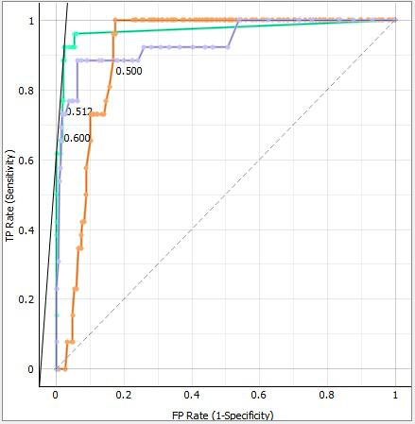
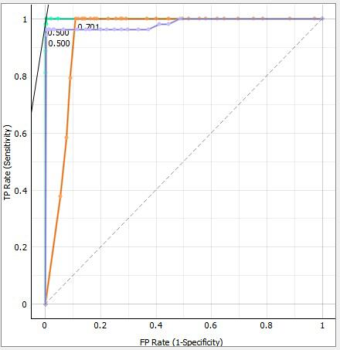
Artificial Neural Network
ROC Analysis (Receiver operating characteristic)
Penman model Stefans-Stewart model
Department of Civil Engineering, RNSIT Bengaluru.

Slide 51

OBJECTIVES OF THE PROPOSED WORK
To Estimate the reference evaporation(ET) by using PM method(FAO 56).
To evaluate how much each metrological variables contributed to trend of ET.
To calculate each climate variables’variations in ET i.e., sensitivity analysis.
To evaluate the performance ET calculations using ANN “Artificial Neural Network”.
Department of Civil Engineering, RNSIT Bengaluru. 40

Slide 52
CONCLUSIONS
Conventional methods were applied on the climate variables out of which PM method and Stefans-Stewarts method gave relatively closer results to the actual evaporation.
Sensitivity analysis was carried out and wind speed and solar radiation were the variables that influenced ET the most.
Trend analysis was conducted and it was found that minimum temperature , maximum temperature, relative humidity showed a positive trend whereas wind speed and sunshine hours showed a negative trend.
Artificial Neural Network for Soft Computing in Orange software was carried out, out of which it was found that Stephans-Stewart method showed better results.
Overall, this report contributes to the advancement of evaporation prediction using soft computing techniques, highlighting their potential as reliable tools for addressing the challenges associated with accurate estimation of evaporation rates.
Department of Civil Engineering, RNSIT Bengaluru. 42

Slide 53
REFERENCES
1. Snyder,Morteza,Scott and Mark. (2005), “Simplified Estimation of Reference Evapotranspirationfrom Pan Evaporation Data in California”, Journal of Irrigigation Drain Engineering 2005.131:249-253.
2. Terzi, Keskin,(2006)”Estimating Evaporation Using ANFIS”,Journal of Irrigation and drainge engineering (ASCE) 2006.132:503-507.
3. Cahoon ,Thomas A.(1990),”Estimating pan evaporation using limited meteorological observations”,Agricultural and Forest Meteorology (Elsevier)0168-1923.
4 M.O. Ahmed, “Trend Analysis of Evaporation and Solar Radiation using Innovative Trend Analysis Method”, J Fundam Appl Sci. 2021, 13(2), 1030-1055.
5. I. J. Verma, “Recent variations and trends in pan evaporation over India”,Journal of Irrigation and drainge engineering (ASCE) 3 (July 2008), 347-356.
6. Hossein Tabari, “Changes of Pan Evaporation in the West of Iran” ,Water Resour Manage (2011) 25:97–111.
Mostafa Ali Benzaghta, Thamer A. Mohammed, Abdul Halim Ghazali and Mohd Amin Mohd Soom, “Prediction of evaporation in tropical climate using artificial neural network and climate based models”, Scientific research and essays 2012, 7(36) ,3133-3148.
Pankaj Kumar and Ajai Kumar Tiwari, “Evaporation Estimation using artificial neural network”, International Journal of Computer Theory and Engineering 2012, 4(1), 51-53.
Surinder Deswal and Mahesh Pal, “Artificial Neural Network based modeling of Evaporation losses in reservoirs”, World academy of Science, Engineering and Technology 2008, 39, 279-283.
Department of Civil Engineering, RNSIT Bengaluru. 10

Slide 54
REFERENCES
10. Anurag Malik, Anil Kumar and Ozgur Kisi (2018), “Daily Pan Evaporation Estimation Using Heuristic Methods”, Journal of Irrigigation Drain Engineering, 2018, 144(9)
11. Subhankar Debnath, Sirisha Adamala and N. S. Raghuwanshi (2015), “Sensitivity Analysis of FAO-56 Penman-Monteith Method for Different Agro-ecological Regions of India”, Springer International Publishing Switzerland 2:689–704
12. Milan Gocic and Slavisa Trajkovic(2013), “Analysis of changes in meteorological variables using Mann-Kendall and Sen's slope estimator statistical tests in Serbia”, Global and Planetary change 100, 172-182
13. Gicy M. Kovoor and Lakshman Nandagiri (2018), “Sensitivity Analysis of FAO-56 Penman– Monteith Reference Evapotranspiration Estimates Using Monte Carlo Simulations”, Springer Nature Singapore Pte Ltd. 73 V.
Department of Civil Engineering, RNSIT Bengaluru. 39

Slide 55
Thank You.

